Slide 1

Operators & Conditions
Session 2
Hassan Ahmed
@Hassan Ahmed

Slide 2
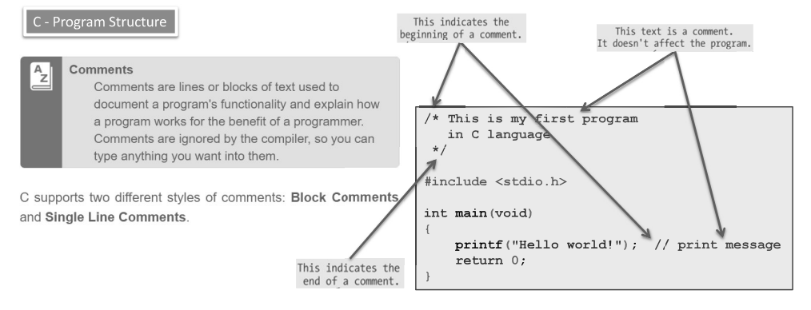
Review

Slide 3
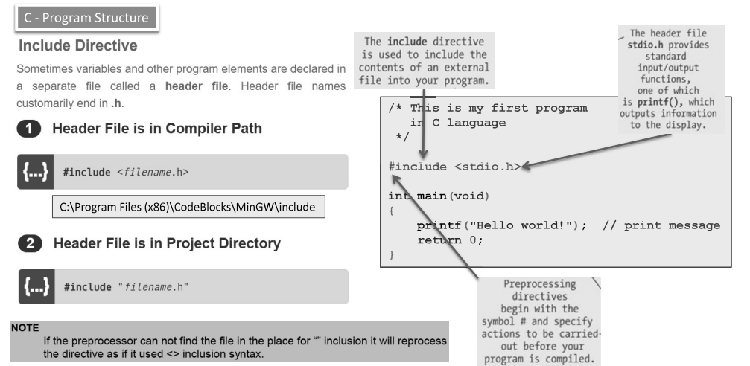
Review

Slide 4
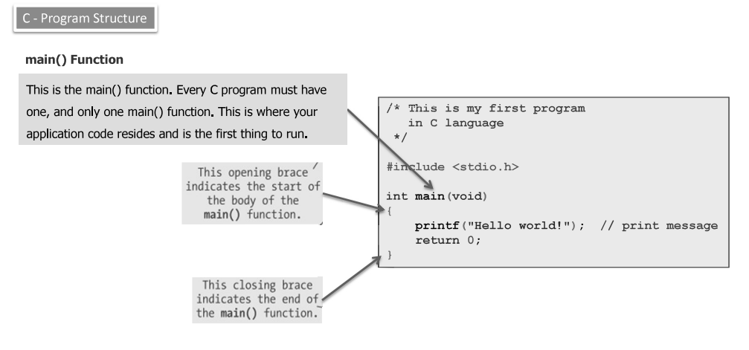
Review

Slide 5
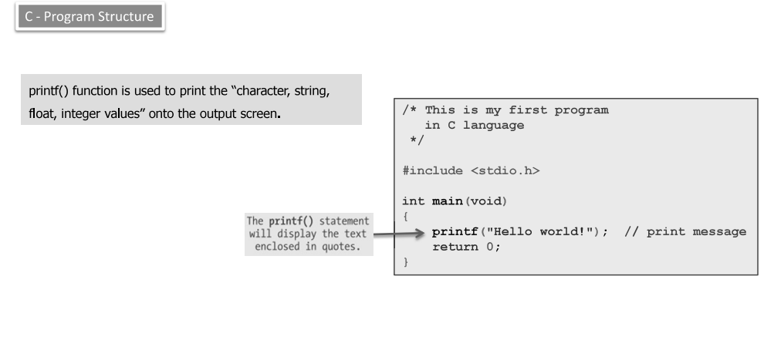
Review

Slide 6
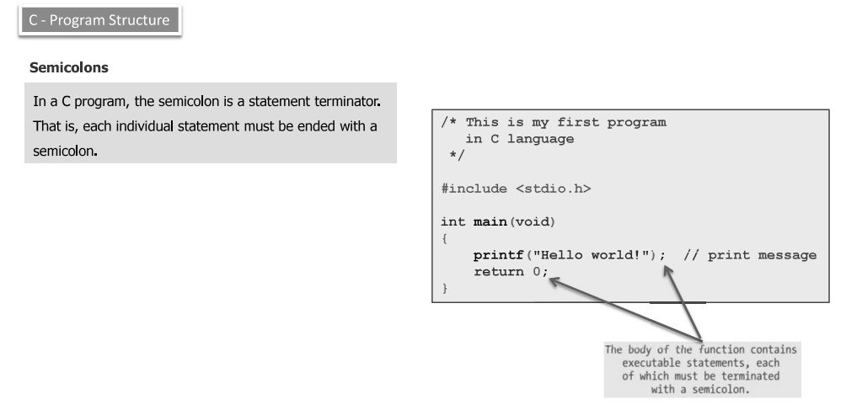
Review

Slide 7
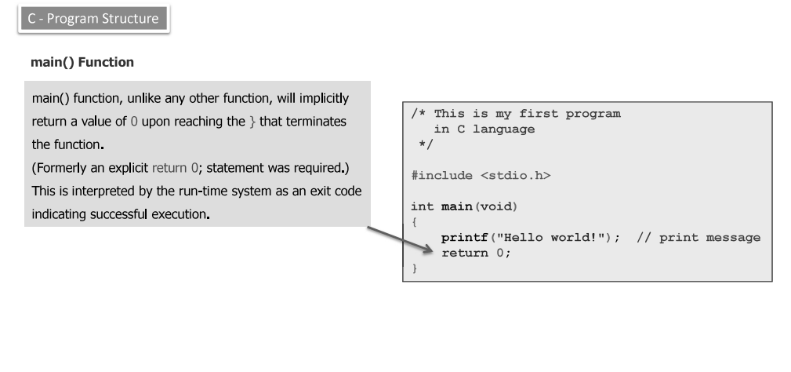
Review

Slide 8
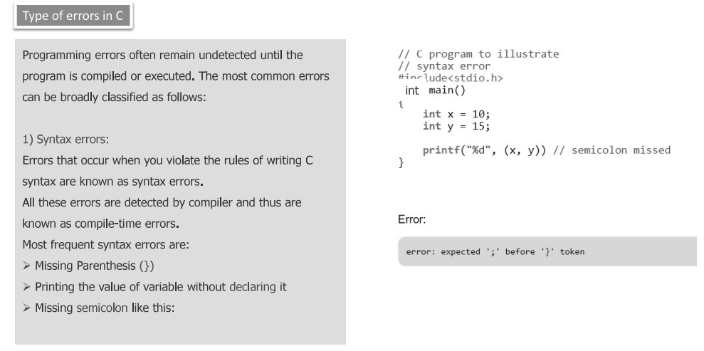

Slide 9
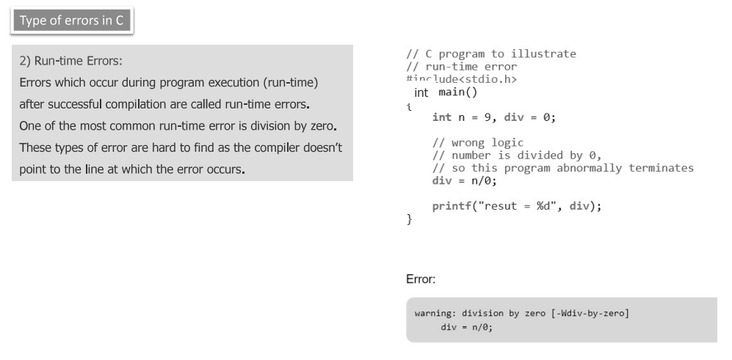

Slide 10
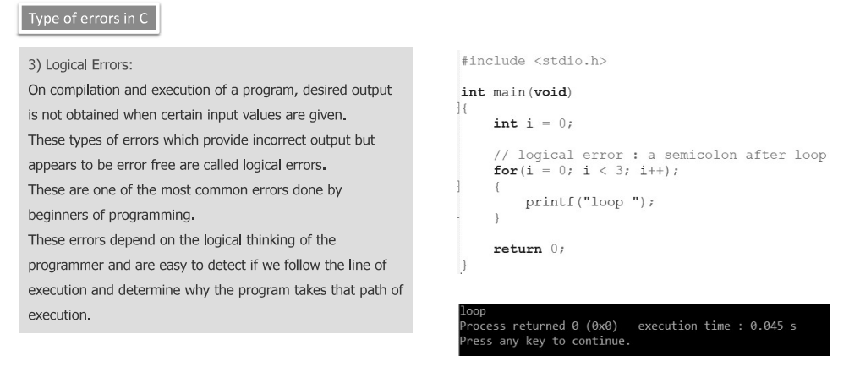

Slide 11
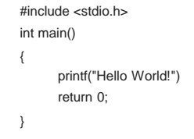
What is the error in the following code ?

Slide 12
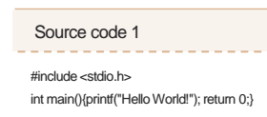
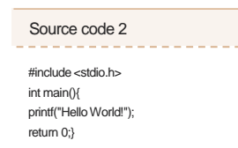
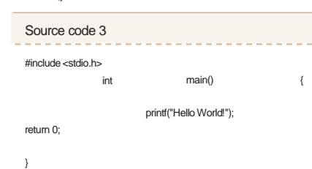
Which of these will run without any errors?

Slide 13
Variables’ identifiers are given against set of rules,
Identifiers must start with underscore “_” or a letter
Identifiers can only contain alpha-numeric characters and underscore
Identifiers are CASE-SENSTIVE
Reserved words “keywords” are not allowed to be used as identifiers

Slide 14
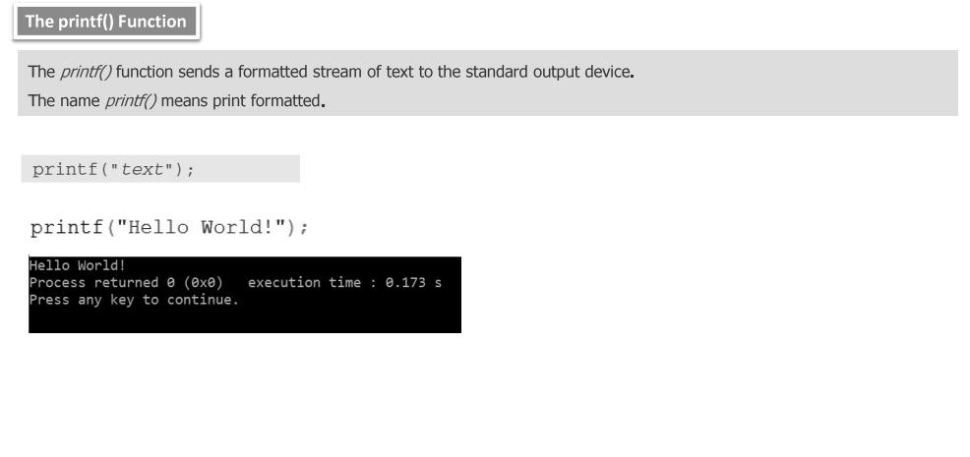

Slide 15
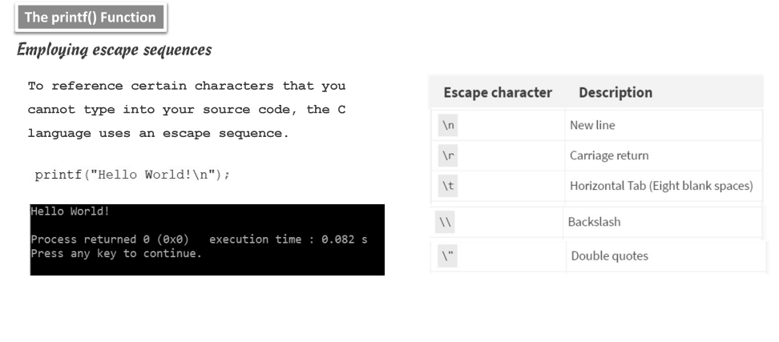

Slide 16
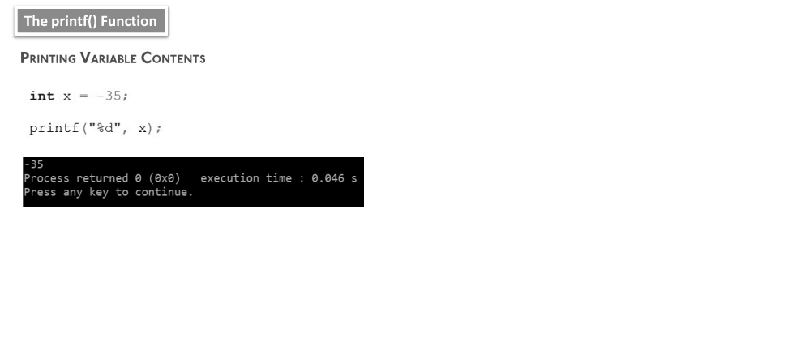

Slide 17
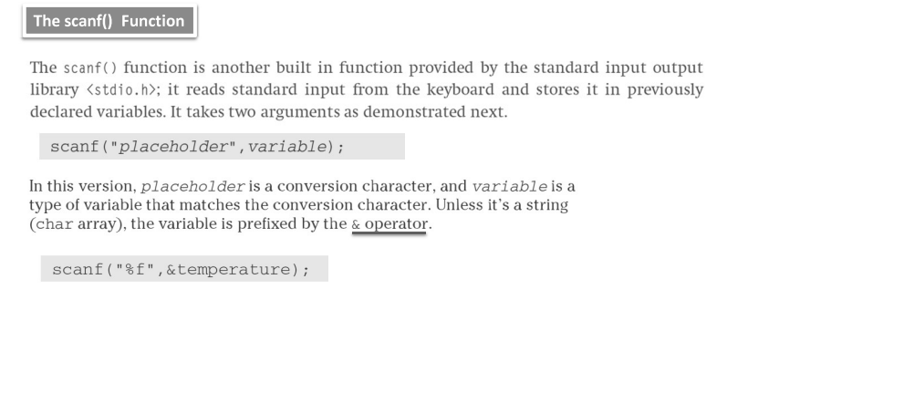

Slide 18
Operations
Operators
Arithmetic
Comparison
Logical
Assignment
+ - * / % ++ --
< <= > >= == !=
&& || !
= += -= *= /= %=

Slide 19
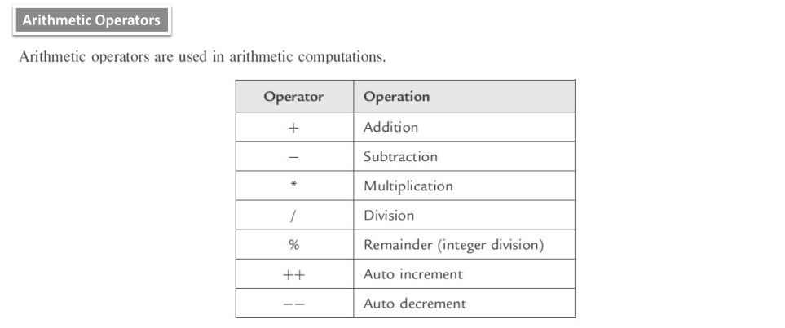

Slide 20
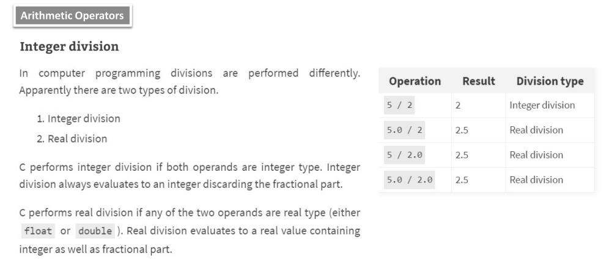

Slide 21
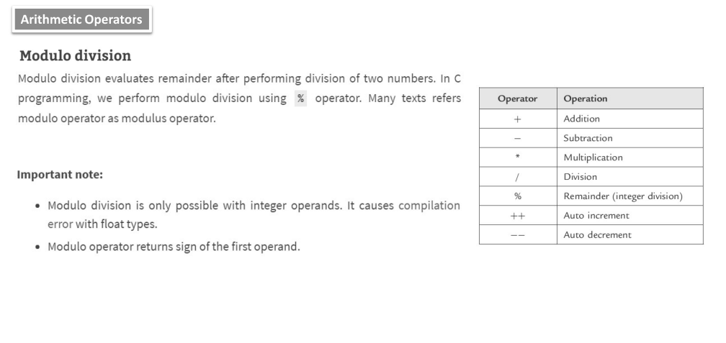

Slide 22
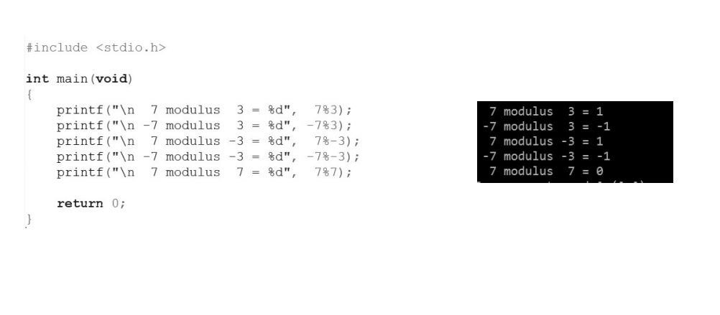

Slide 23
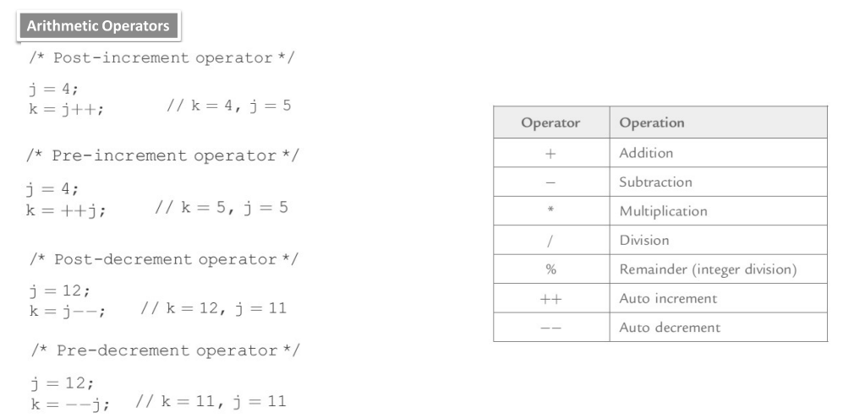

Slide 24
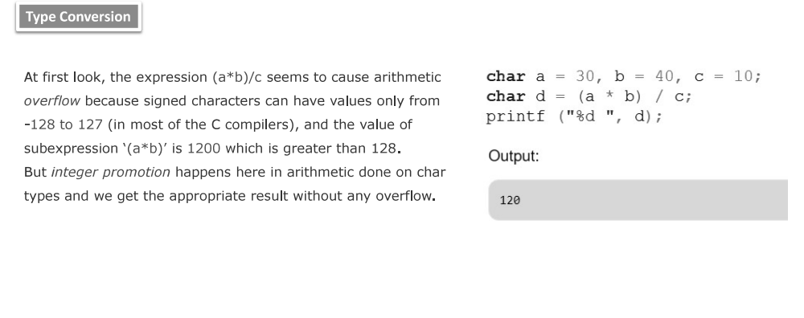

Slide 25
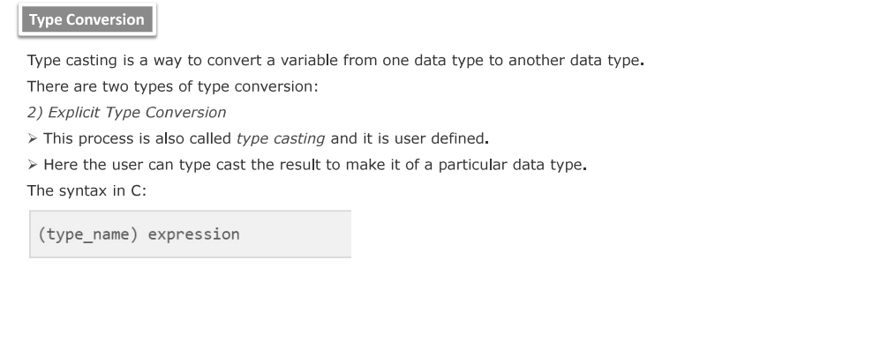

Slide 26
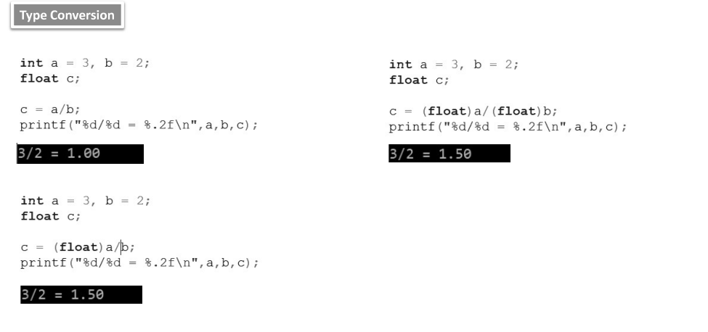

Slide 27
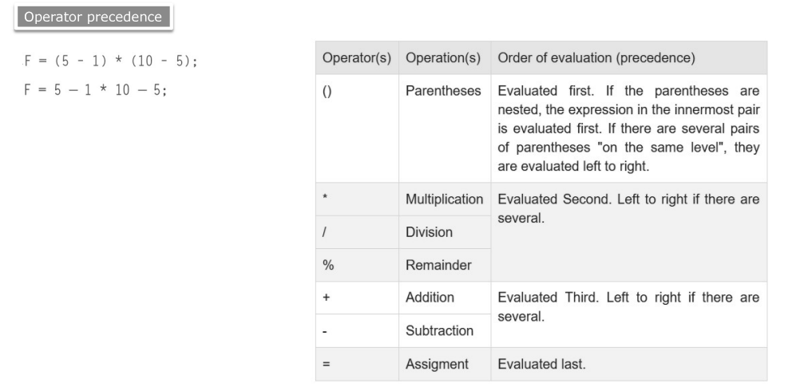

Slide 28
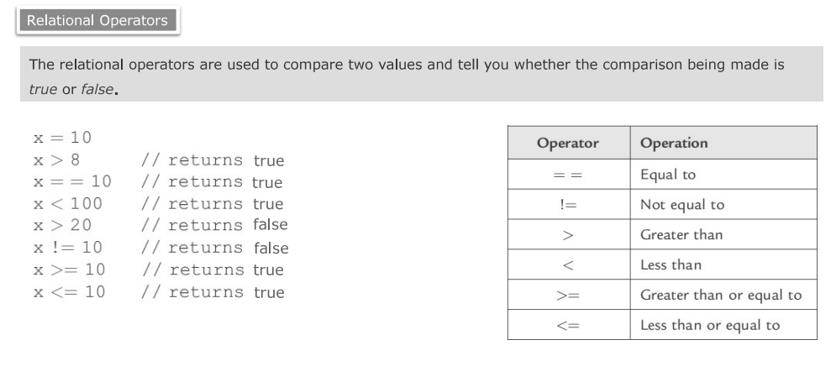

Slide 29
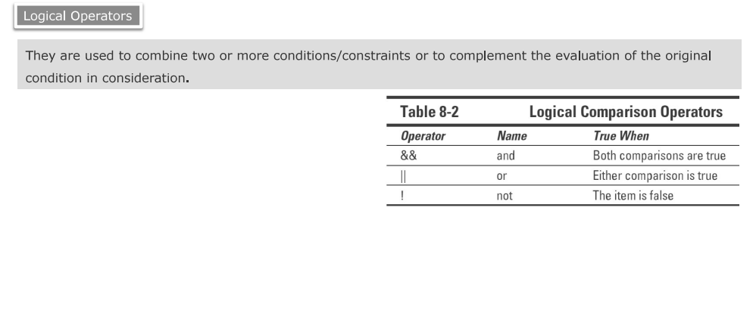

Slide 30
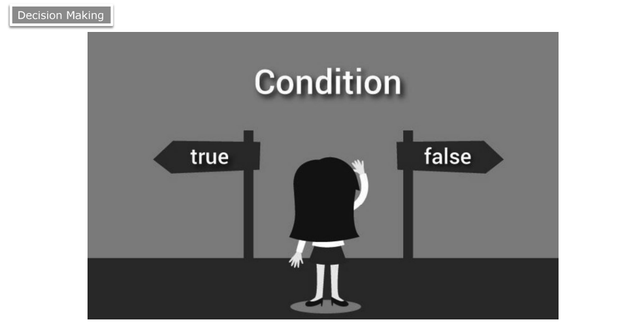

Slide 31
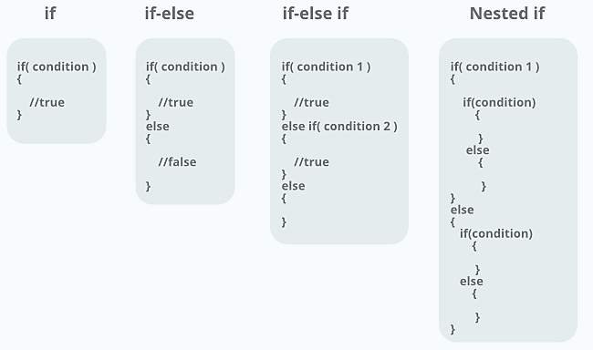

Slide 32
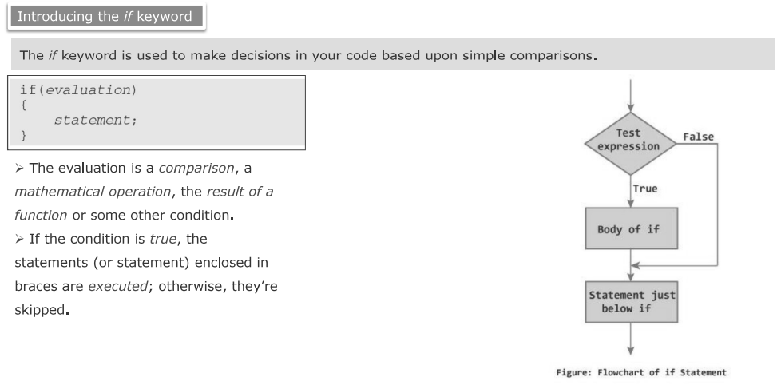

Slide 33
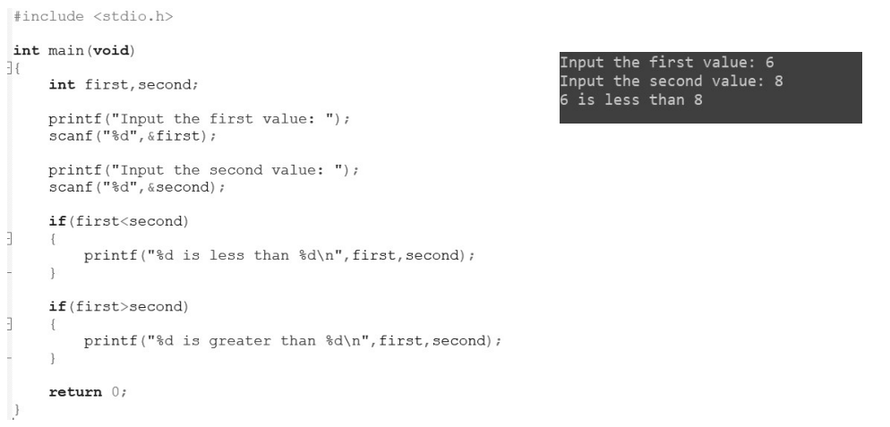

Slide 34
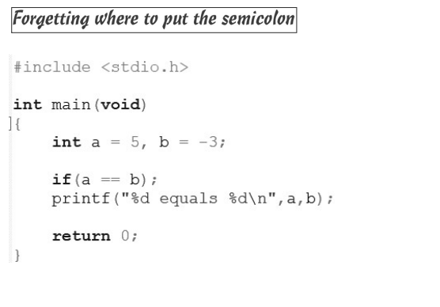

Slide 35
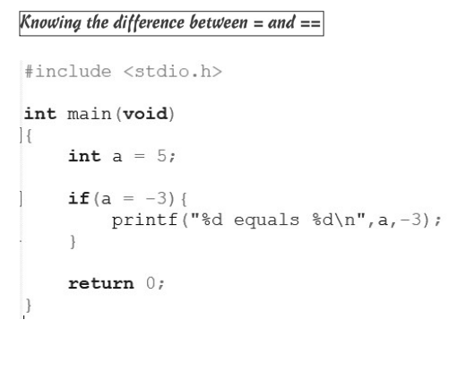

Slide 36
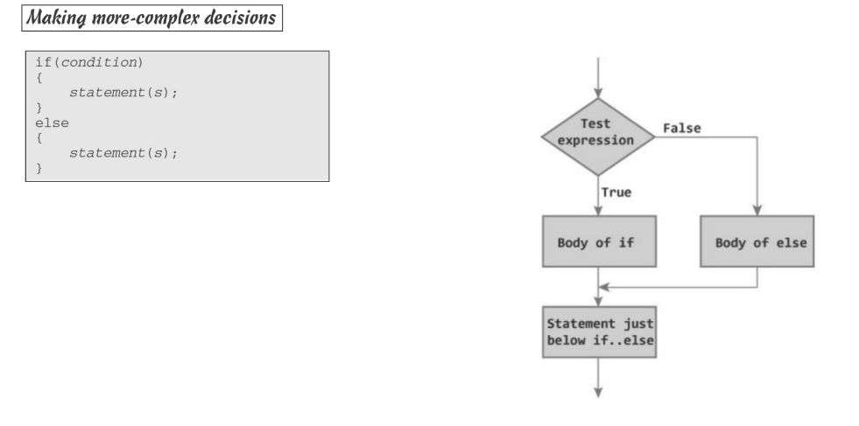

Slide 37
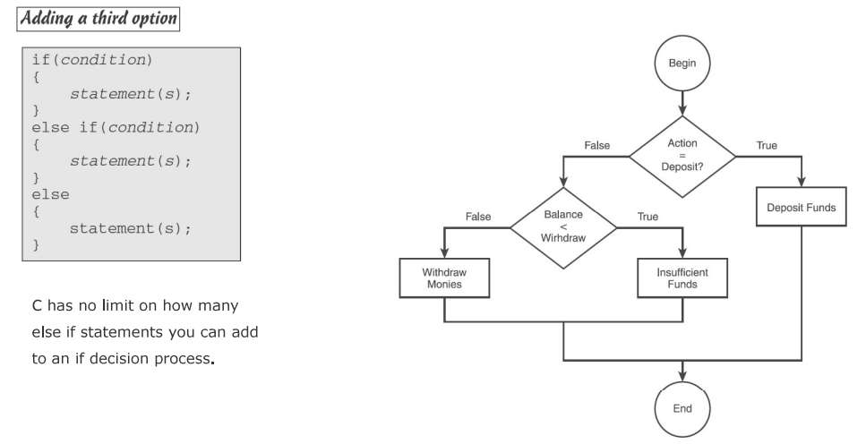

Slide 38
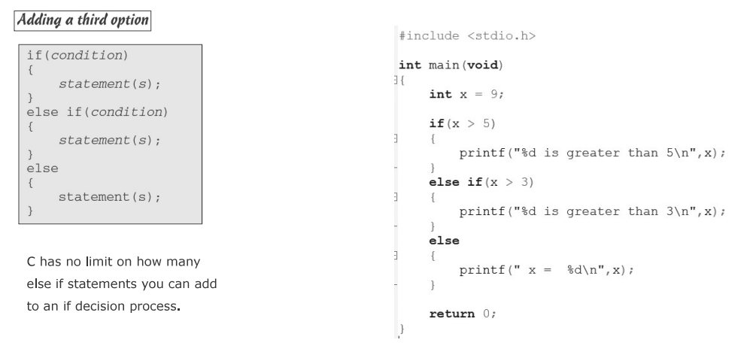

Slide 39
Tasks:
1- find max number of three numbers.
2- build a simple calculator that can add, subtract, divide, multiply and mod only 2 operands.
3- build a simple scientific calculator that utilizes the logic gates using the logical operators on 2 operands only.
4- Given 3 numbers A, B and C, Print the minimum and the maximum numbers.
5- Given two numbers A and B. Print "Yes" if A is greater than or equal to B. Otherwise print "No".
6- Given four numbers A, B, C and D. Print the result of the following equation :
X = (A * B) - (C * D).
7 - Given two numbers X and Y. Print the summation and multiplication and subtraction of these 2 numbers.

Slide 40
Thank you!

